Slide 1
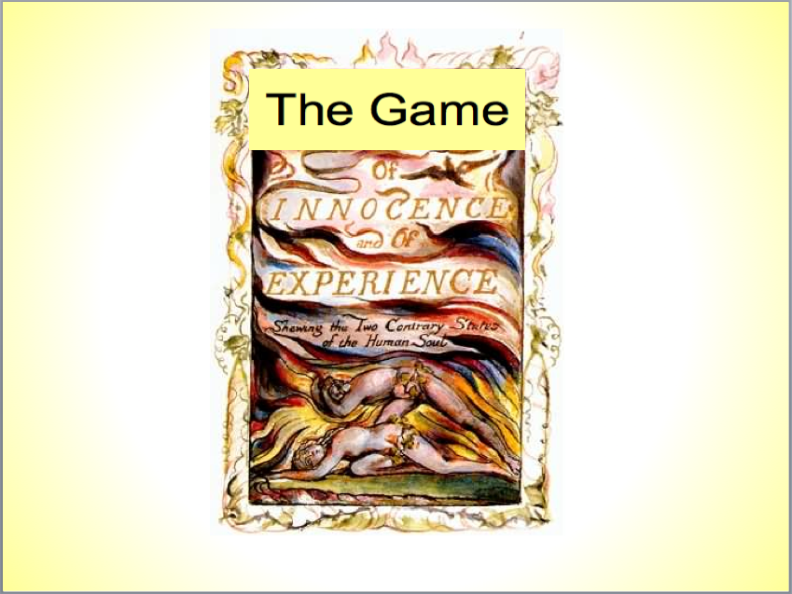
By Kenny Croyle, Emily Mendoza, Kevin Maulhardt, and Ed Hwang
Notes:
Kenny

Slide 2
How to Play
There are 8 rounds. Each round will have either a pair of poems by Blake or a picture.
If the slide has a pair of poems, you will decide which version of the poem you feel more accurately represents the situation the poem describes.
If the slide shows a picture, choose the option that you associate with the picture.
Keep track of how often you choose A or B.
Notes:
Kevin

Slide 3
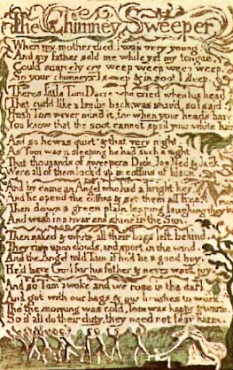
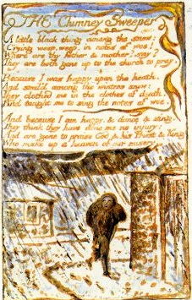
The Chimney Sweeper
There was a great deal of child labor in 18th century England. Young boys of about 4 or 5 were sold, and used to clean chimneys because they were small enough to climb inside. This practice was socially acceptable and common at this time.
Notes:
Kenny

Slide 4
The Chimney Sweeper
Which version of the poem do you think better describes the situation that the chimney sweeper is in?
A) The young chimney sweepers may have to work hard and do dirty work at a young age, but they will be rewarded for their hard work in the next life. Their cheerful songs show that they are content with their position.
B) The young boys are manipulated to hide the fact that they are miserable and oppressed. They are taught cheerful songs so they look happy and are told stories of the next life to keep them working hard.
Notes:
Kenny

Slide 5
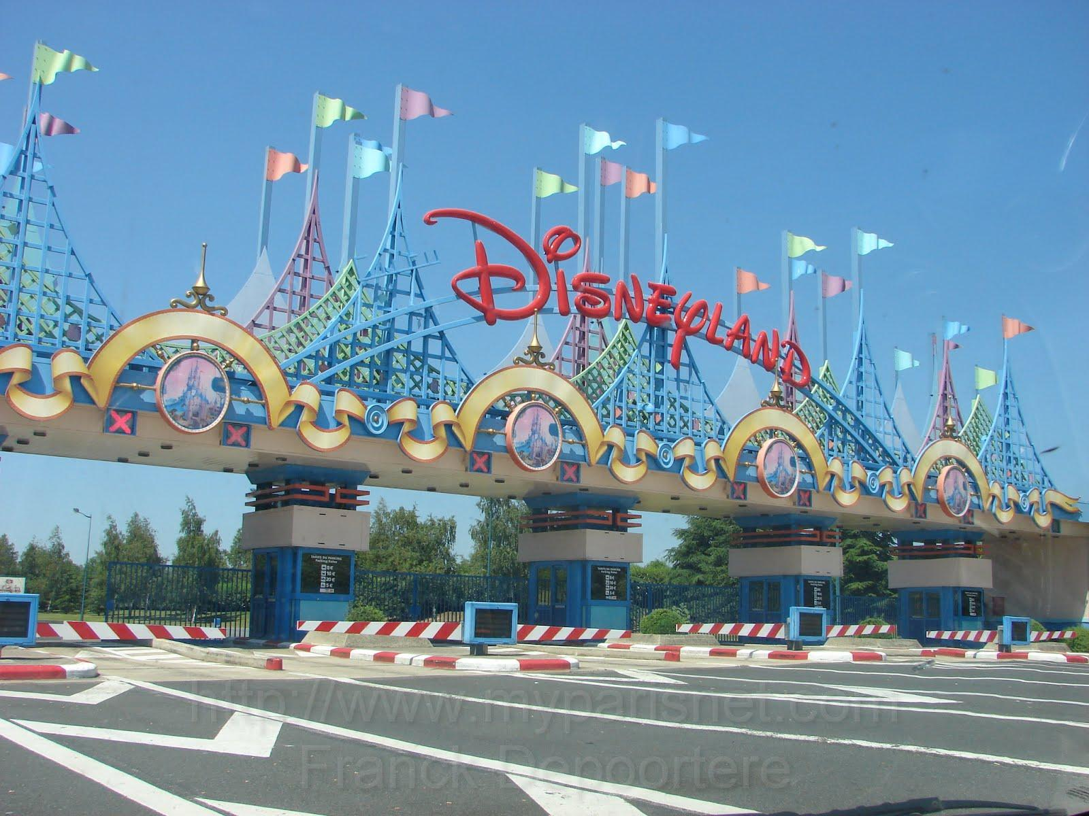
Does this image remind you of:
A) Memorable vacations and fun with family and/or friends.
B) Overpriced food, parking, admission, huge crowds, and long lines.
Notes:
Kenny

Slide 6
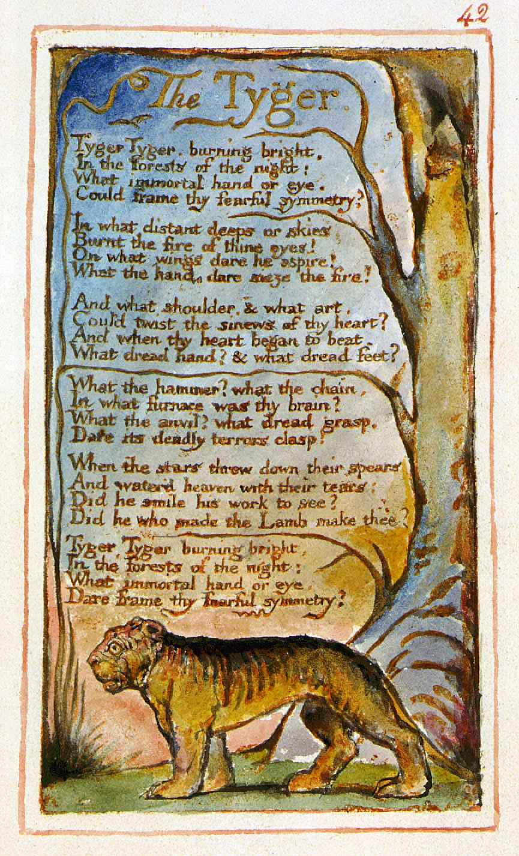
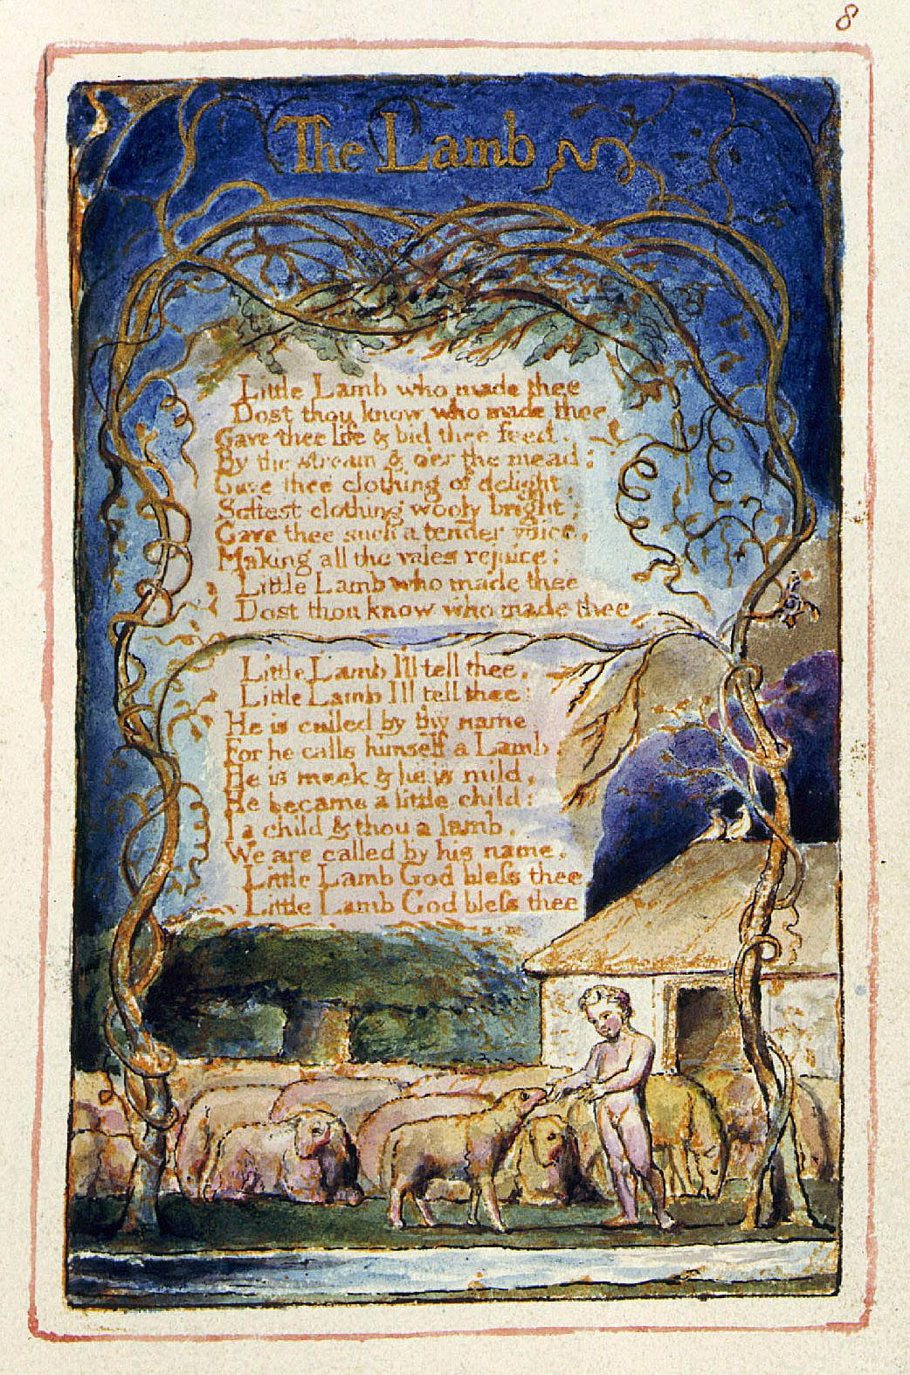
The Tyger and The Lamb
These twin poems both
cover a perspective on
religion, as the lamb
represents good and pure
things and the tyger
represents mystery and
evil. They give a better
picture of what Blake was
trying to convey together
rather than seperately.
The tyger especially
highlights God's absolute
power and the fact that
evil is something that
cannot be denied.
Meanwhile, The Lamb
shows a God that is all
good.
Notes:
Emily

Slide 7
The Tyger and The Lamb
Which poem do you think best represents the way the world is?
A) The world is a good place filled with people that really do have good intentions
B) Everything is evil and corrupt and no one should be trusted
Notes:
Emily

Slide 8
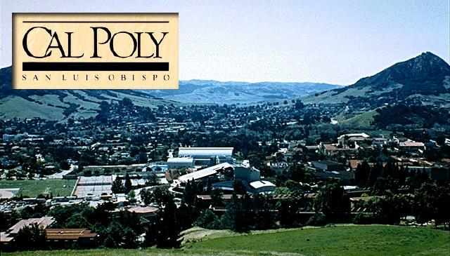
Does coming back to campus after a break remind you of:
A) All of your friends you will get to see and all the fun things to do?
B) All of the homework, studying, and hard work you will have to do this quarter (not to mention the 4 year tuition)?
Notes:
Emily

Slide 9
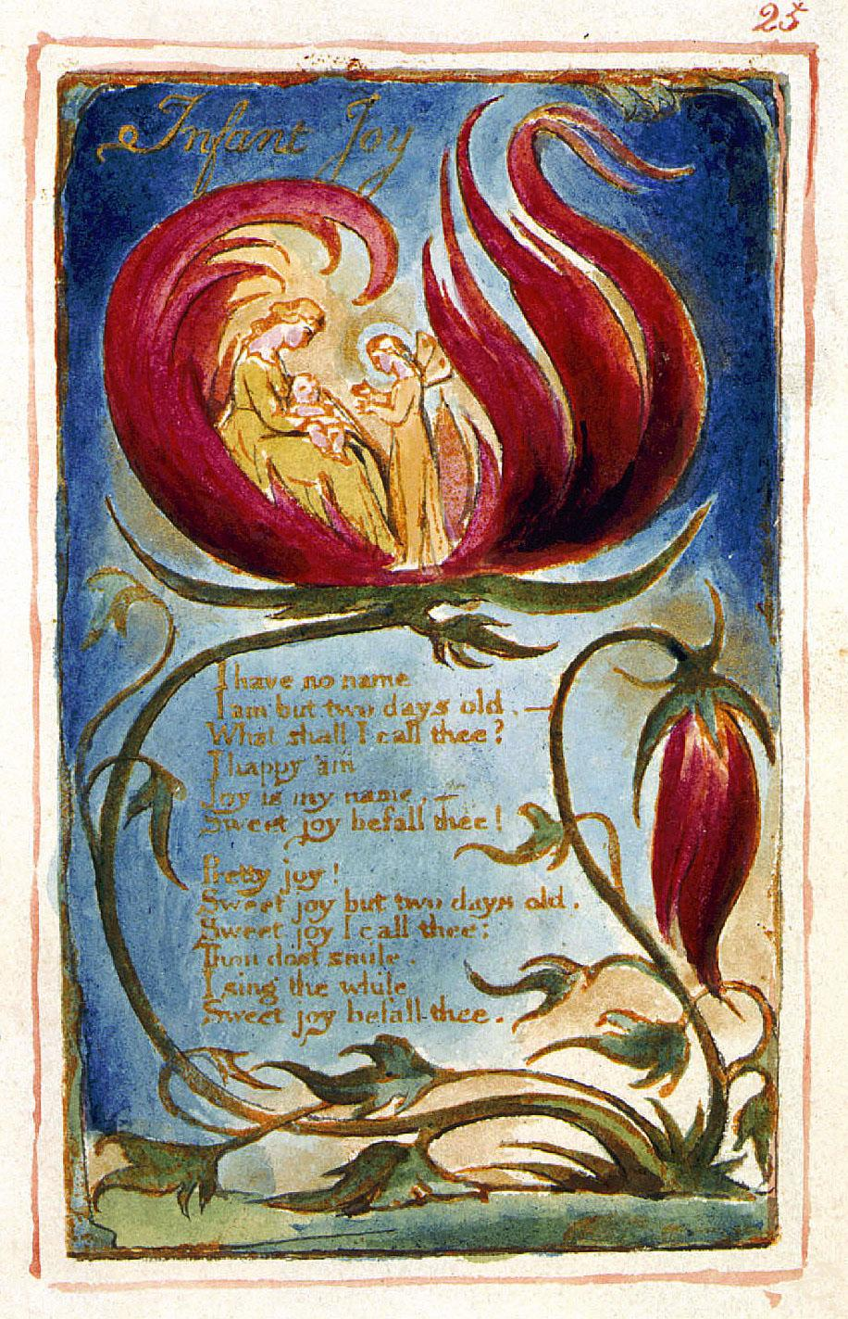
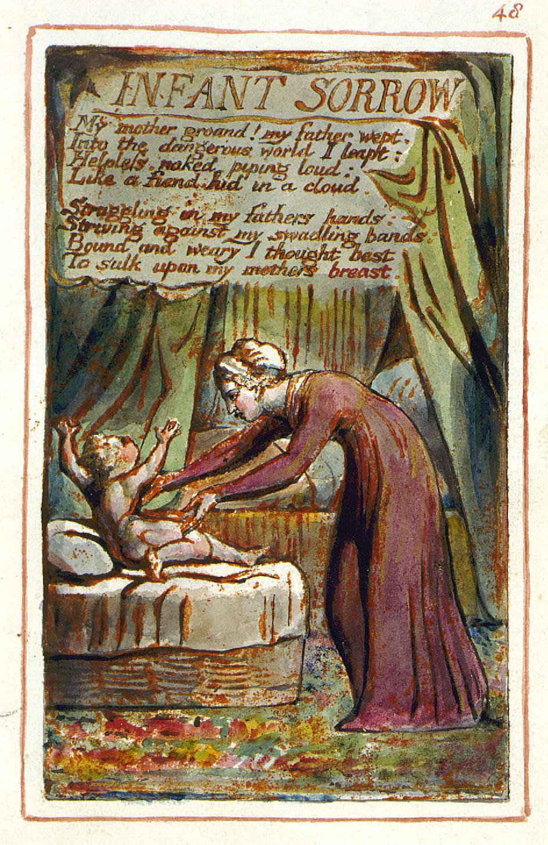
Infant Joy vs Infant Sorrow
These two poems highlight the alternate perspectives of new life. On one end of the spectrum, a new life is something exquisitely beautiful derived from its complexity in nature and seen as the beginning of great things to come. On the other end, the view of experience inevitably has to foreshadow the struggles, horrors, and all other evils that the infant might face.
Notes:
Kevin

Slide 10
Infant Joy vs Infant Sorrow
Should an infant take a perspective of the world that more associates with:
the joy associated with discovery, the possibilities of greatness, and the beautiful aspects of nature or
B) The inevitable evils that are faced along the journey of life, or the bumps and obstacles, so to speak.
Notes:
Kevin

Slide 11
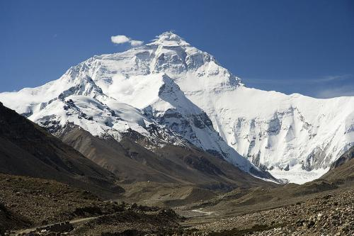
Position yourself at the bottom of a grueling hike ahead up a mountain (above: Everest). Is your focus on:
A) the euphoric moments of making it to the top and reaching your goal, or
B) the gut wrenching aches and pains, blood chilling temperatures, and paper-thin air all to be endured.
Notes:
Kevin

Slide 12
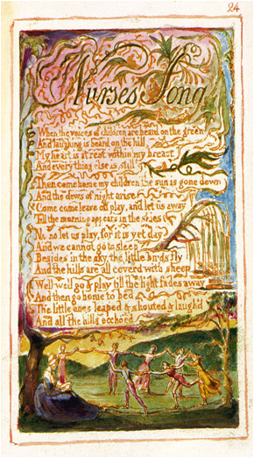
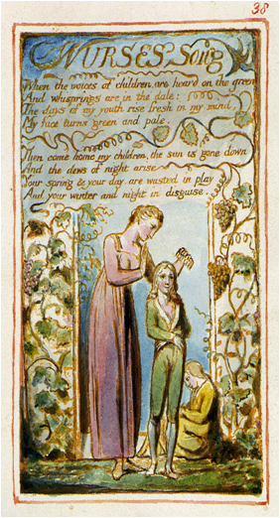
Nurse's Song
Children are playing outside in the hills, while the nurse looks on. The two songs show two different point of views from the nurse. One has a positive outlook and encourages innocence while the other has a negative one and seeks to suppress it.
Notes:
Ed

Slide 13
Nurse's Song
Which outlook should people take on life as they age?
A) Remember how it felt to be young and pass that feeling on to the youth.
B) Become more bitter as one ages and be jealous of those who are young.
Notes:
Ed

Slide 14
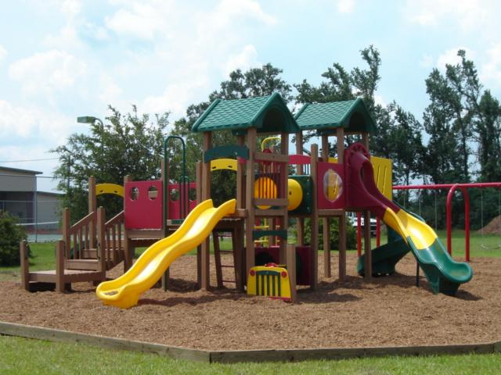
How do you feel when you see a playground?
A) Elementary school was the life: lets go play on it.
B) The playground is too childish and I have better things to do.
Notes:
Ed

Slide 15
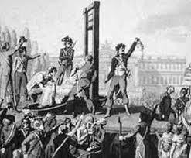
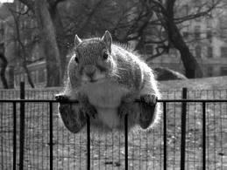
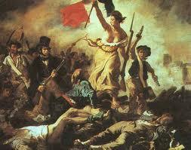
Tally up Your As and Bs
0-2 As and 6-8 Bs
You are bitter and disenchanted, much like William Blake when the French Revolution got out of control
3-5 As and 3-5 Bs
You are either a neutral or balanced person
6-8 As and 0-2 Bs
You are upbeat and optimistic, much like William Blake at the beginning of the French Revolution
You are Experienced
You are Sitting on the Fence
You are Innocent
Notes:
Ed or Emily

Slide 16
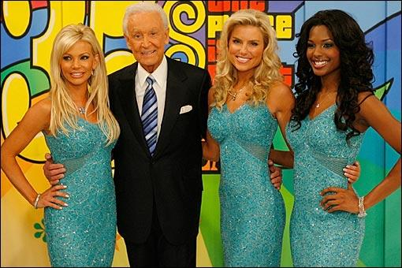
Remember, help control the pet population. Have your pet spayed or neutered!
Notes:
Kenny

